Slide 1
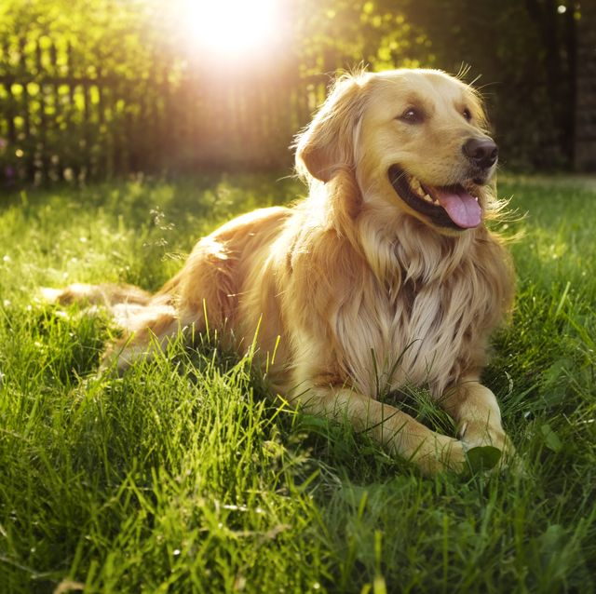
DOG BREED CLASSIFICATION
GROUP – 2
SRUJAN SWAROOP - IMT2016033
Siddarth reddy - IMT2016037
Durga Yasasvi - IMT2016060
Rohith yogi - IMT2016072

Slide 2
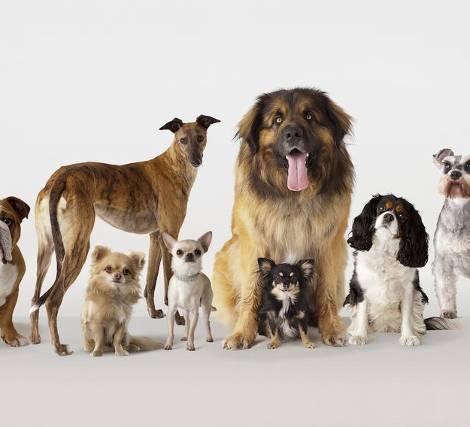
Objective
The aim of this project is to detect the dog by localized bounding boxes and categorize them into their respective breed.

Slide 3
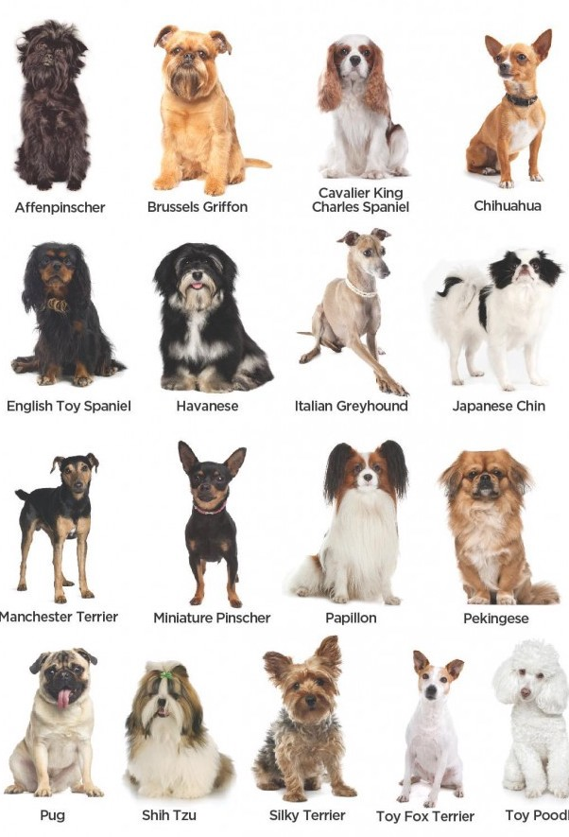
DATASET
The Stanford Dogs dataset contains images of 120 breeds of dogs from around the world. This dataset has been built using images and annotation from ImageNet for the task of fine-grained image categorization :-
Number of categories: 120
Number of images: 20,580
Annotations: Class labels, Bounding boxes
Number of train Images: 12000
Number of test images: 8580

Slide 4
OVERVIEW
This is a fine grained detection and classification problem.
Therefore uses YOLO like model to localize bounding boxes and classify the detected dog. We use YOLO-v1 for object detection and classification.
YOLO has set of pretrained convolutional layers followed by randomly initialized convolutional layers and fully connected layers.
Since images of our dataset are directly annotated from ImageNet dataset hence the first few convolutional layers are pre trained on ImageNet dataset.

Slide 5
APPROACH
The pre-trained network used is VGG-16 network instead of conventional Darknet trained on ImageNet Data Set.
Challenges in the dataset:
Low inter breed and High intra breed variations.
Occlusion.
Dogs of same breed having different colors, sizes, etc...
Postures, Textures.
With these challenges, it becomes a tough task to classify their breeds.
Since there is low inter breed variation and high intra breed variation the convolutional features should be precise enough to find the distinction withinand across different breeds.
Therefore pretrained model which has higher accuracy on ImageNet data set is preferred.

Slide 6
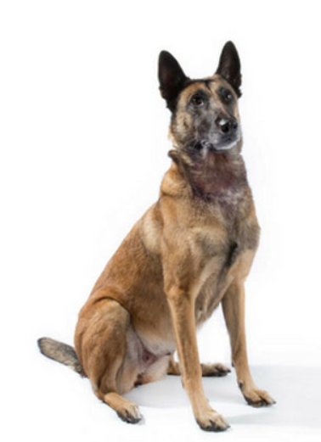
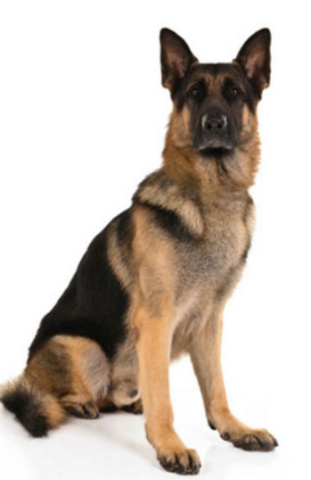
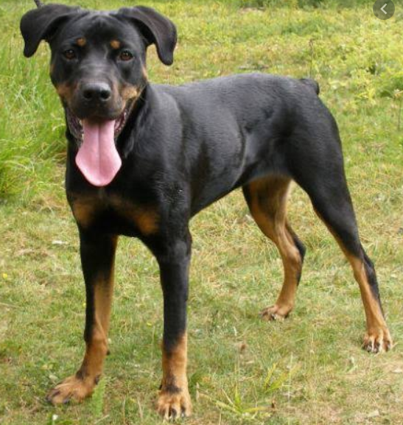
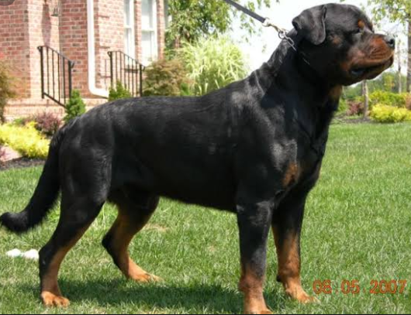
Belgian Malinois
German Shepherd
Rottweiler
Low Inter Breed Variation
High Intra Breed Variation

Slide 7
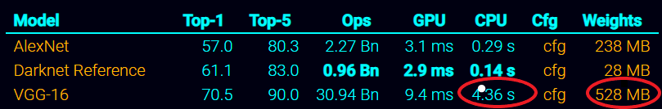
Need for trade-off
Accuracy over Speed
VGG-16 is more accurate than Darknet Reference but significantly slower than Darknet Reference, hence cannot perform real time detection and classification.
Note: Darknet Reference refers to the smaller/tiny version of the Darknet framework.

Slide 8
NETWORK architecture
Our network was inspired from YOLO v1 architecture.
In our architecture, we replaced the Darknet framework (the first 20 layers) with the VGG-16 Net (which was pretrained on ImageNet dataset).
Followed by the VGG-16 network we added:-
1 convolutional layer &
3 fully connected layers.

Slide 9
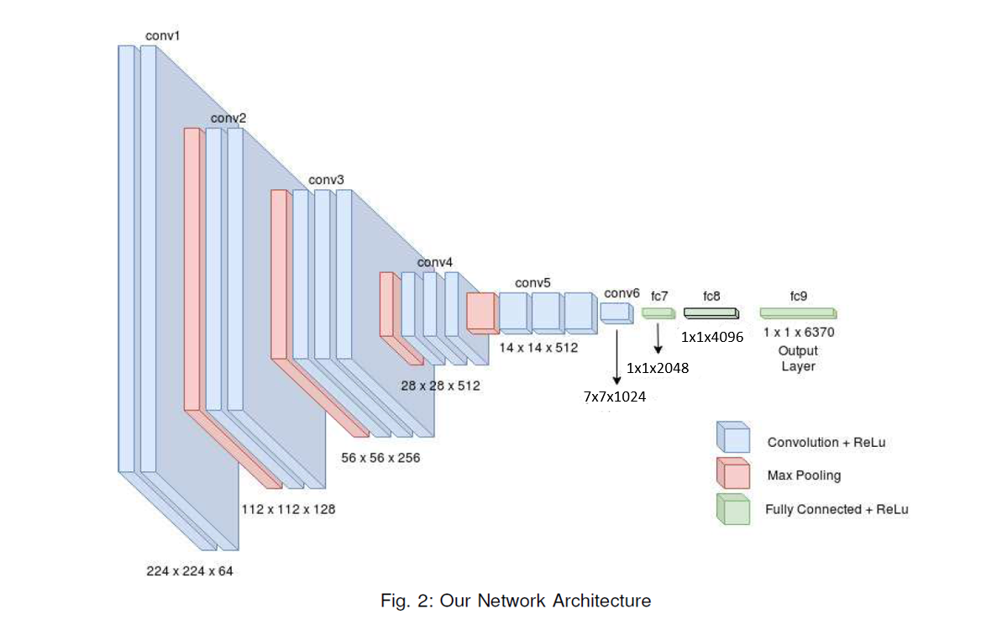
Network Architecture
7 x 7 x 130

Slide 10
Architectural reasons
The requirement of number of convolutional layers is less than fully connected layers because :-
The data set is directly annotated from ImageNet dataset and VGG-16 is already pre-trained on ImageNet for classification task.
Hence the convolutional features required for classification is already learnt, therefore additional fully connected layers are added to localize the dog by regressing the bounding box co-ordinates for each grid present in the image.
Since the pretrained network is used, the task now orients more towards detection rather than classification.

Slide 11
Network architecture
As it is dog breed specific classification task, the variability between the classes is very low, the requirement of number of convolutional layers after pretrained network is not abundant as features of the dogs are assumed to be learnt during pretraining of VGG-16 on ImageNet dataset.
Therefore the intention of adding layers turned more towards object detection rather than pure classification. Hence number of convolutional layers added are less as compared to fully connected layers as bounding coordinates needed to be regressed
The output is reconstructed into 7 x 7 x 130 tensor which encodes all 5 parameters information for all the bounding boxes.

Slide 12
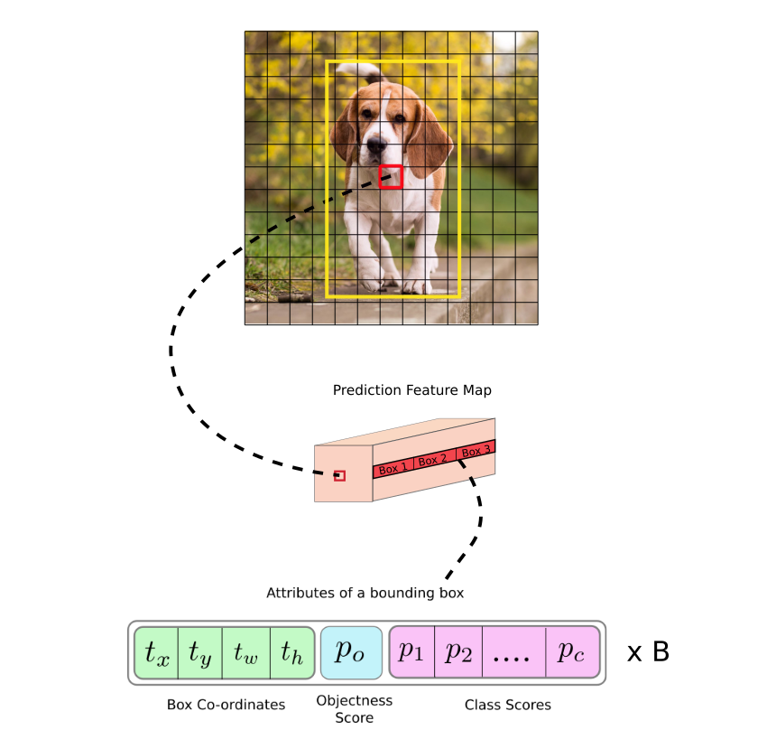

Slide 13
Output-tensor
Final output layer outputs a tensor which has following information.
Predictions for each grid cell for B bounding boxes
For each bounding box {x, y, w, h} is predicted along with the corresponding confidence score which tells about how confidence about how accurate the predicted bounding box is.
Along with above predictions each grid cell also predicts C class conditional probabilities.
This information is encoded as S x S x(B x 5 + C) tensor. As S is size of each grid, B is number of bounding boxes predicted for each grid cell ,C is the number of classes.

Slide 14
Dimensions of output tensor
grid size(S)=7.
number of bounding boxes predicted for each grid(B)=2
number of dog breed classes(C)=120
Therefore our output tensor is in the form 7 x 7 x (2 x 5 + 120)
=49 x (10 + 120)
= 49x130
=(6370) .
Dimension of output tensor: 1x 1 x 6370

Slide 15
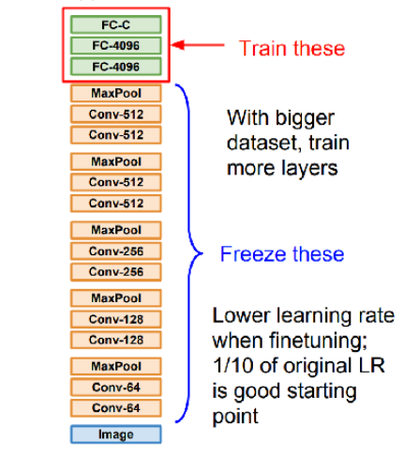
training
Transfer learning:
We chose VGG-16 network trained on ImageNet as the dog breed dataset is quite similar to the ImageNet dataset. Also as our dataset is quite heavy as well, we used transfer learning on these pretrained networks by training on last few fully conneceted layers by freezing the rest of the network.

Slide 16
Fine-tuning
As our dataset is large enough and has very similar data to ImageNet, we finetune a few layers and with a very few learning rate we train the remaining layers. So, in our model the lower layers contain may be features of dog and higher layers contains breed specific information.
Inorder to prevent over-fitting and preserve generalization, we freeze the lower layers of pre-trained network. To implement this property we enforce a very low learning rate such that loss gradient is not propagated to lower layers of the network.
Hence our learning rate is :-
learning − rate= 0.0001
Loss Function: Same loss function was used as given in YOLO v1.

Slide 17
training
The training is carried through the following mentioned configuration:
Model trained for 110 epochs.
Each epoch consisting of 300 iterations.
Total number of iterations for which the model trained is 33,350 iterations descent is carried through mini batches of size-32(Mini batch gradient descent).
Each image sample is used in training in normalized form.
Batch normalization is applied for all the batches and batches of image samples are selected in random fashion.
Added a dropout layer with dropout probability 0.5 just before final output layer which helps as a regularizer.

Slide 18
Testing
Inference: We pass the test image through the network which outputs the 7 x 7 x 130. Now from this tensor we need to perform some post processing to get the final output. We perform confidence thresholding and Non maximum suppression.
Confidence Thresholding: We consider only the predictions above a certain threshold (around 0.2). All the bounding boxes with confidence scores less 20% are not considered further.
Non Maximum Suppression: The main purpose of non-maximum suppression is to pick one of the multiple candidates for object. So it eliminates some candidates that are different detections of the same object. It makes sure that the object is identified only once.
After Non maximum suppression, we output the optimal bounding box fit for the dog present in the image and the class label corresponding to the highest class conditional probability.

Slide 19
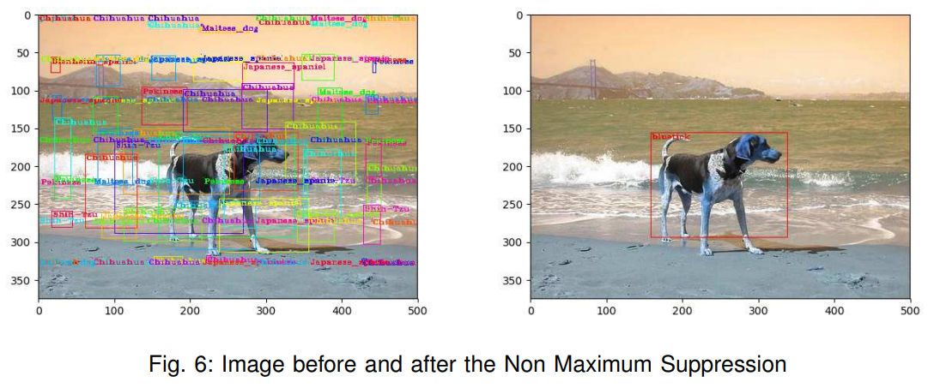
Non maximum suppression

Slide 20
comparisons
We trained on different pretrained networks like VGG-16, AlexNet and YOLO-tiny:
Following are the mAP accuracies obtained for different networks:
VGG-16: 66.12%
YOLO-tiny: 59.89%
AlexNet: 48.23%
VGG-16 was significantly more accurate than remaining pretrained networks. But in terms of computation darknet was effectively faster than VGG-16. Compared to the rest Alexnet exhibited poor performance.

Slide 21
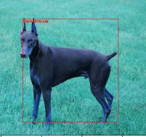
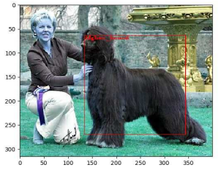
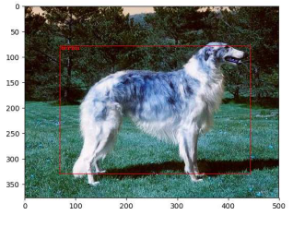
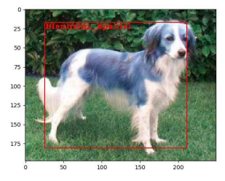
Few predicted outputs

Slide 22
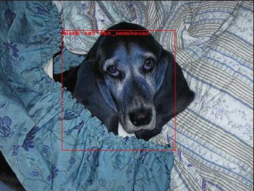
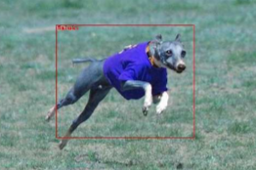
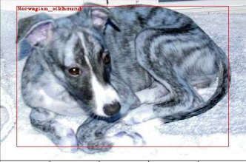
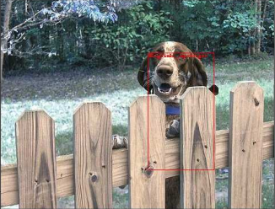
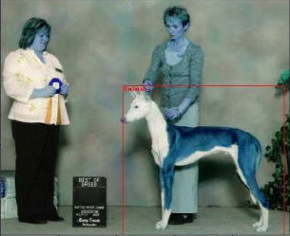
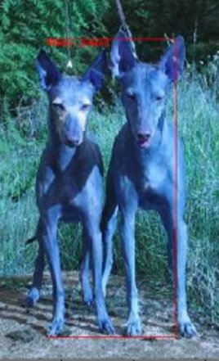
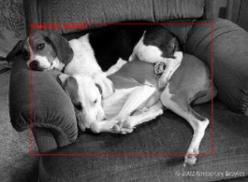
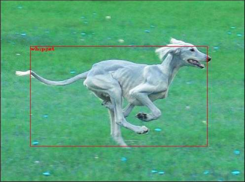
FEW MORE PREDICTED OUTPUTS
Here are the results where there are people present, posture, occlusion, different poses, etc... Irresespective of these things, our model abled to correctly classify them.
But it failed for the case where there are two dogs present together. The model detected it as a single dog.

